Slide 1
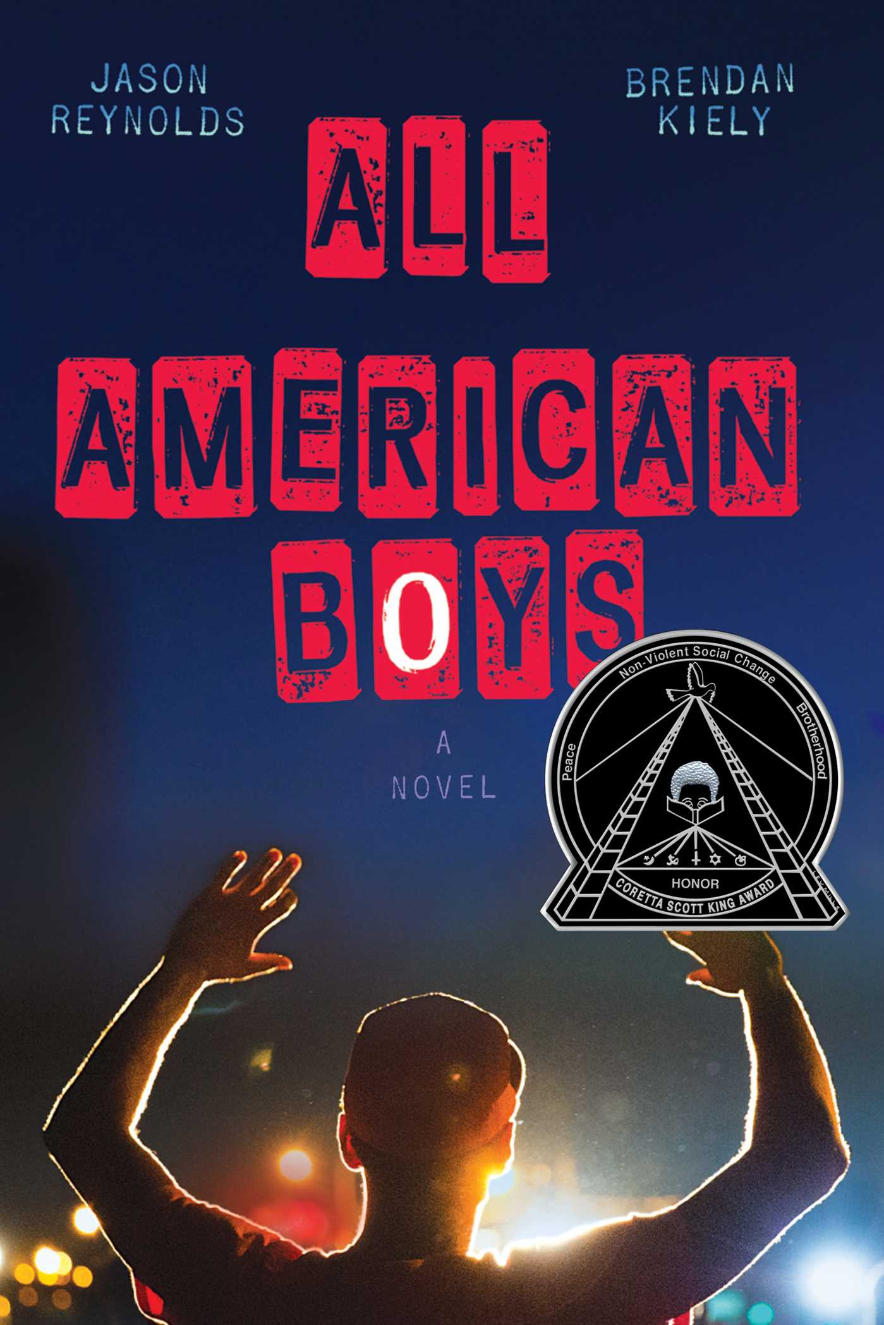
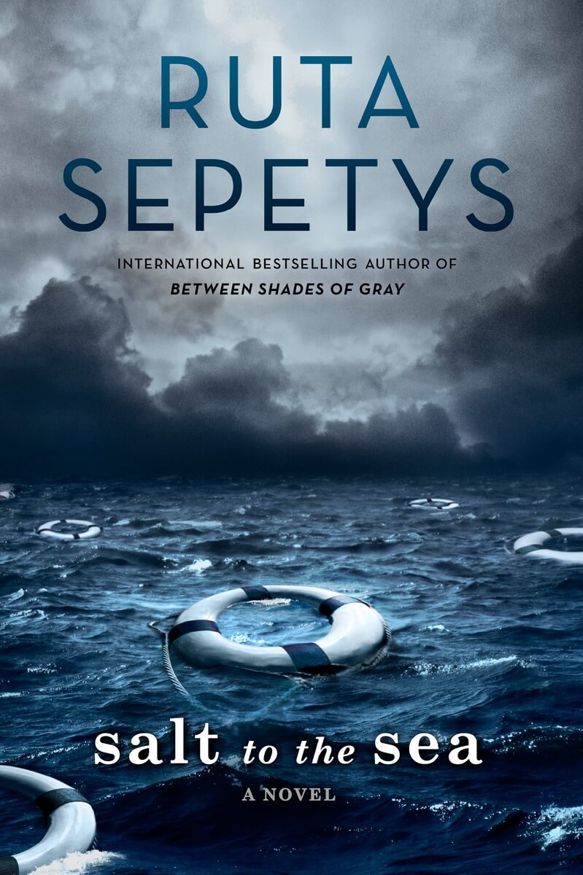
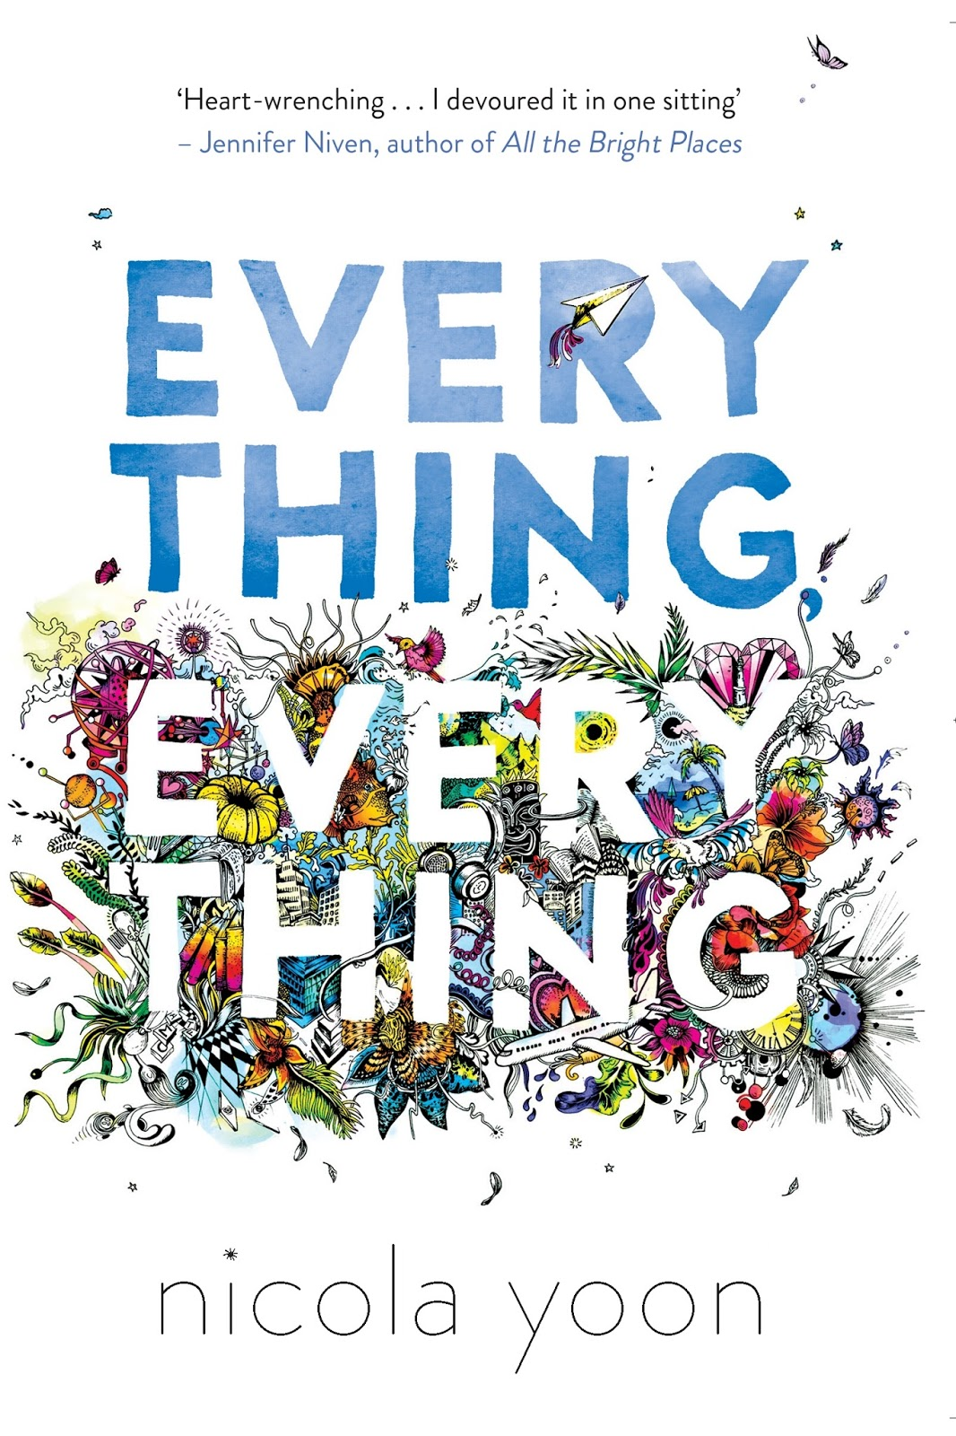
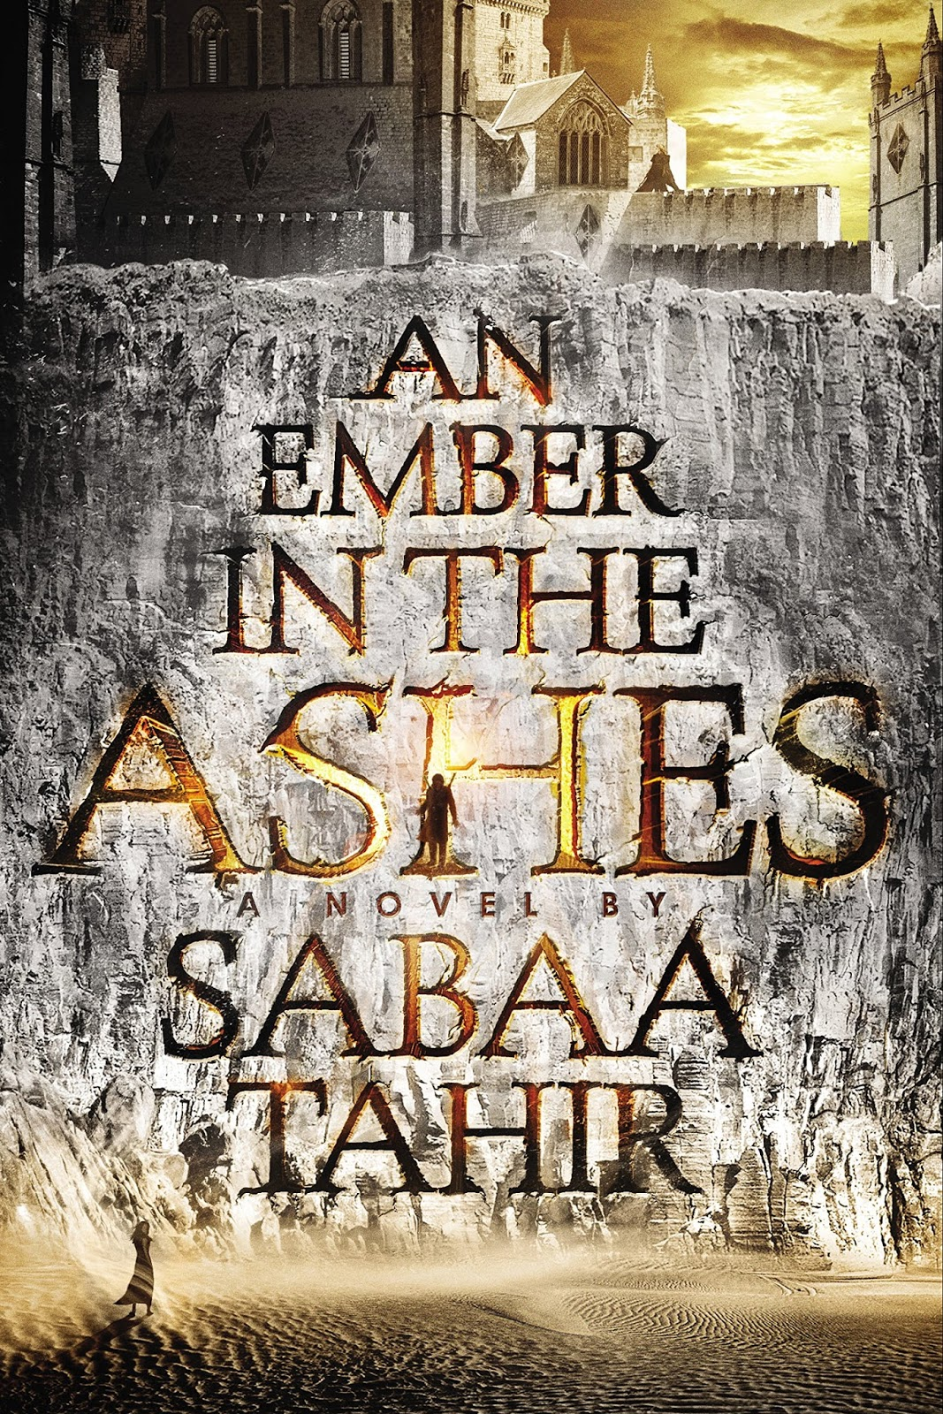
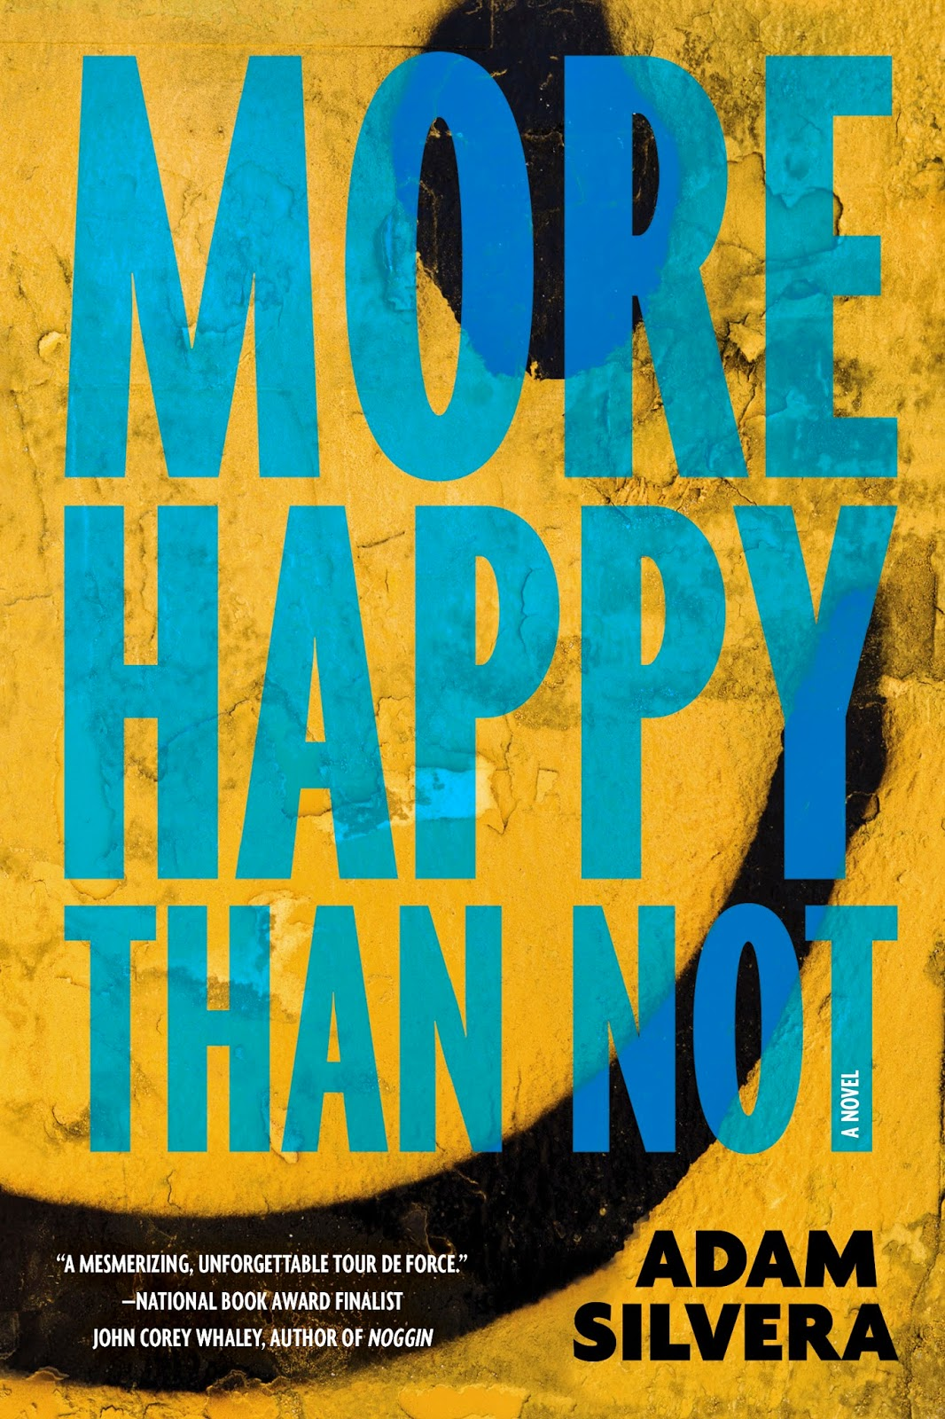
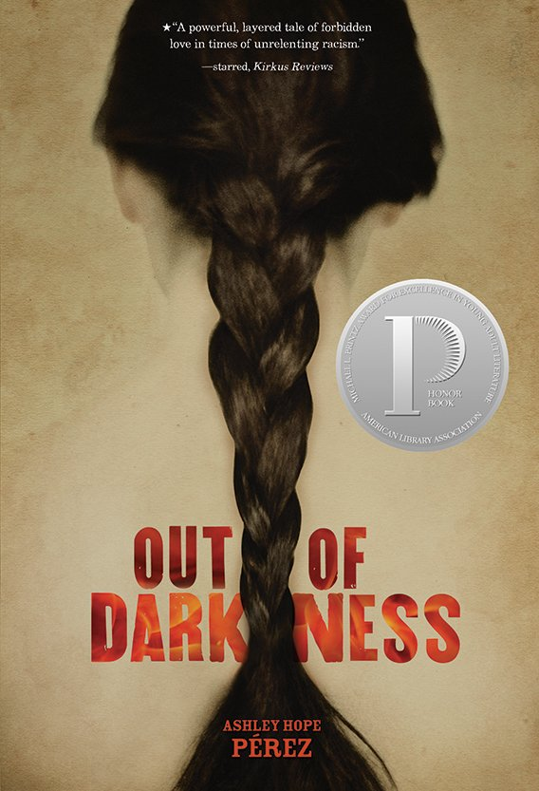
Virginia Readers Choice
Middle School
High School 2017 - 2018

Slide 2
All American Boys by Jason Reynolds & Brendan Kiely
Rashad is absent again today. That’s the sidewalk graffiti that started it all… Well, no, actually, a lady tripping over Rashad at the store, making him drop a bag of chips, was what started it all. Because it didn’t matter what Rashad said next—that it was an accident, that he wasn’t stealing—the cop just kept pounding him. Over and over, pummeling him into the pavement.
So then Rashad, an ROTC kid with mad art skills, was absent again…and again…stuck in a hospital room. Why? Because it looked like he was stealing. And he was a black kid in baggy clothes. So he must have been stealing. And that’s how it started. And that’s what Quinn, a white kid, saw. He saw his best friend’s older brother beating the daylights out of a classmate. At first Quinn doesn’t tell a soul…He’s not even sure he understands it. And does it matter? The whole thing was caught on camera, anyway. But when the school—and nation—start to divide on what happens, blame spreads like wildfire fed by ugly words like “racism” and “police brutality.” Quinn realizes he’s got to understand it, because, bystander or not, he’s a part of history. He just has to figure out what side of history that will be.
Rashad and Quinn—one black, one white, both American—face the unspeakable truth that racism and prejudice didn’t die after the civil rights movement. There’s a future at stake, a future where no one else will have to be absent because of police brutality. They just have to risk everything to change the world. Cuz that’s how it can end.

Slide 3
All the Bright Places by Jennifer Niven
The Fault in Our Stars meets Eleanor and Park in this exhilarating and heart-wrenching love story about a girl who learns to live from a boy who intends to die.
Soon to be a major motion picture starring Elle Fanning!
Theodore Finch is fascinated by death, and he constantly thinks of ways he might kill himself. But each time, something good, no matter how small, stops him.
Violet Markey lives for the future, counting the days until graduation, when she can escape her Indiana town and her aching grief in the wake of her sister’s recent death.
When Finch and Violet meet on the ledge of the bell tower at school, it’s unclear who saves whom. And when they pair up on a project to discover the “natural wonders” of their state, both Finch and Violet make more important discoveries: It’s only with Violet that Finch can be himself—a weird, funny, live-out-loud guy who’s not such a freak after all. And it’s only with Finch that Violet can forget to count away the days and start living them. But as Violet’s world grows, Finch’s begins to shrink.
This is an intense, gripping novel perfect for fans of Jay Asher, Rainbow Rowell, John Green, Gayle Forman, and Jenny Downham from a talented new voice in YA, Jennifer Niven.

Slide 4
Dumplin’ by Julie Murphy
Self-proclaimed fat girl Willowdean Dickson (dubbed “Dumplin’” by her former beauty queen mom) has always been at home in her own skin. Her thoughts on having the ultimate bikini body? Put a bikini on your body. With her all-American beauty best friend, Ellen, by her side, things have always worked…until Will takes a job at Harpy’s, the local fast-food joint. There she meets Private School Bo, a hot former jock. Will isn’t surprised to find herself attracted to Bo. But she is surprised when he seems to like her back.
Instead of finding new heights of self-assurance in her relationship with Bo, Will starts to doubt herself. So she sets out to take back her confidence by doing the most horrifying thing she can imagine: entering the Miss Clover City beauty pageant—along with several other unlikely candidates—to show the world that she deserves to be up there as much as any twiggy girl does. Along the way, she’ll shock the hell out of Clover City—and maybe herself most of all.
With starry Texas nights, red candy suckers, Dolly Parton songs, and a wildly unforgettable heroine—Dumplin’ is guaranteed to steal your heart.

Slide 5
An Ember in the Ashes by Sabaa Tahir
Laia is a slave. Elias is a soldier. Neither is free.
Under the Martial Empire, defiance is met with death. Those who do not vow their blood and bodies to the Emperor risk the execution of their loved ones and the destruction of all they hold dear.
It is in this brutal world, inspired by ancient Rome, that Laia lives with her grandparents and older brother. The family ekes out an existence in the Empire’s impoverished backstreets. They do not challenge the Empire. They’ve seen what happens to those who do.
But when Laia’s brother is arrested for treason, Laia is forced to make a decision. In exchange for help from rebels who promise to rescue her brother, she will risk her life to spy for them from within the Empire’s greatest military academy.
There, Laia meets Elias, the school’s finest soldier—and secretly, its most unwilling. Elias wants only to be free of the tyranny he’s being trained to enforce. He and Laia will soon realize that their destinies are intertwined—and that their choices will change the fate of the Empire itself.

Slide 6
Everything Everything by Nicola Yoon
My disease is as rare as it is famous. Basically, I’m allergic to the world. I don’t leave my house, have not left my house in seventeen years. The only people I ever see are my mom and my nurse, Carla.
But then one day, a moving truck arrives next door. I look out my window, and I see him. He’s tall, lean and wearing all black—black T-shirt, black jeans, black sneakers, and a black knit cap that covers his hair completely. He catches me looking and stares at me. I stare right back.
His name is Olly. Maybe we can’t predict the future, but we can predict some things. For example, I am certainly going to fall in love with Olly. It’s almost certainly going to be a disaster.

Slide 7
More Happy Than Not by Adam Silvera
In his twisty, gritty, profoundly moving debut—called “mandatory reading” by the New York Times—Adam Silvera brings to life a charged, dangerous near-future summer in the Bronx.
In the months after his father's suicide, it's been tough for 16-year-old Aaron Soto to find happiness again--but he's still gunning for it. With the support of his girlfriend Genevieve and his overworked mom, he's slowly remembering what that might feel like. But grief and the smile-shaped scar on his wrist prevent him from forgetting completely. When Genevieve leaves for a couple of weeks, Aaron spends all his time hanging out with this new guy, Thomas. Aaron's crew notices, and they're not exactly thrilled. But Aaron can't deny the happiness Thomas brings or how Thomas makes him feel safe from himself, despite the tensions their friendship is stirring with his girlfriend and friends.
Since Aaron can't stay away from Thomas or turn off his newfound feelings for him, he considers turning to the Leteo Institute's revolutionary memory-alteration procedure to straighten himself out, even if it means forgetting who he truly is. Why does happiness have to be so hard?

Slide 8
Notorious RBG: The Life and Times of Ruth Bader Ginsburg by Irin Carmon & Shana Knizhnik
Notorious RBG was co-authored by Irin Carmon
and Shana Knizhnik. Irin is a journalist who
interviewed Ruth Bader Ginsberg for MSNBC
and Shana is the law student responsible for
the creation of the Notorious R.B.G Tumblr
and subsequent international obsession with
Supreme Court Justice Ruth Bader Ginsburg.
Both Irin and Shana have researched and
fact checked every fact presented in the
book, as well as fact checked with the
Notorious RBG herself. In homage to the
Notorious B.I.G the titles for the chapters
have been inspired by his lyrics. Irin and
Shana’s goal in publishing this book is to
lend some light on one of the most underestimated
and misunderstood women who managed to change the world and who
continues to do that to this day.

Slide 9
Out of Darkness by Ashley Hope Perez
“This is East Texas, and there’s lines. Lines you cross,
lines you don’t cross. That clear?”
New London, Texas. 1937. Naomi Vargas and Wash Fuller know about the lines in East Texas as well as anyone. They know the signs that mark them.
“No Negroes, Mexicans, or dogs.”
They know the people who enforce them.
“They all decided they’d ride out in their sheets
and pay Blue a visit.”
But sometimes the attraction between two people is so powerful it breaks through even the most entrenched color lines. And the consequences can be explosive.
“More than grief, more than anger, there is a need. Someone to blame. Someone to make pay.”
Ashley Hope Pérez takes the facts of the 1937 New London school explosion—the worst school disaster in American history—as a backdrop for a riveting novel about segregation, love, family, and the forces that destroy people.

Slide 10
Salt to the Sea by Ruta Sepetys
Winter, 1945. Four teenagers. Four secrets.
Each one born of a different homeland; each one hunted, and haunted, by tragedy, lies…and war.
As thousands of desperate refugees flock to the coast in the midst of a Soviet advance, four paths converge, vying for passage aboard the Wilhelm Gustloff, a ship that promises safety and freedom.
Yet not all promises can be kept.
Inspired by the single greatest tragedy in maritime history, bestselling and award-winning author Ruta Sepetys (Between Shades of Gray) lifts the veil on a shockingly little-known casualty of World War II. An illuminating and life-affirming tale of heart and hope.

Slide 11
Simon vs. the Homo Sapiens Agenda by Becky Albertalli
Sixteen-year-old and not-so-openly gay Simon Spier prefers to save his drama for the school musical. But when an email falls into the wrong hands, his secret is at risk of being thrust into the spotlight.
Now Simon is actually being blackmailed: if he doesn’t play wingman for class clown Martin, his sexual identity will become everyone’s business. Worse, the privacy of Blue, the pen name of the boy he’s been emailing, will be compromised.
With some messy dynamics emerging in his once tight-knit group of friends, and his email correspondence with Blue growing more flirtatious every day, Simon’s junior year has suddenly gotten all kinds of complicated. Now, change-averse Simon has to find a way to step out of his comfort zone before he’s pushed out—without alienating his friends, compromising himself, or fumbling a shot at happiness with the most confusing, adorable guy he’s never met.

