Slide 1
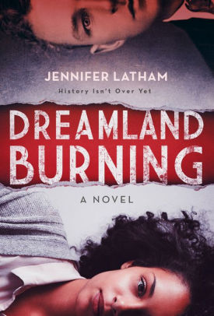
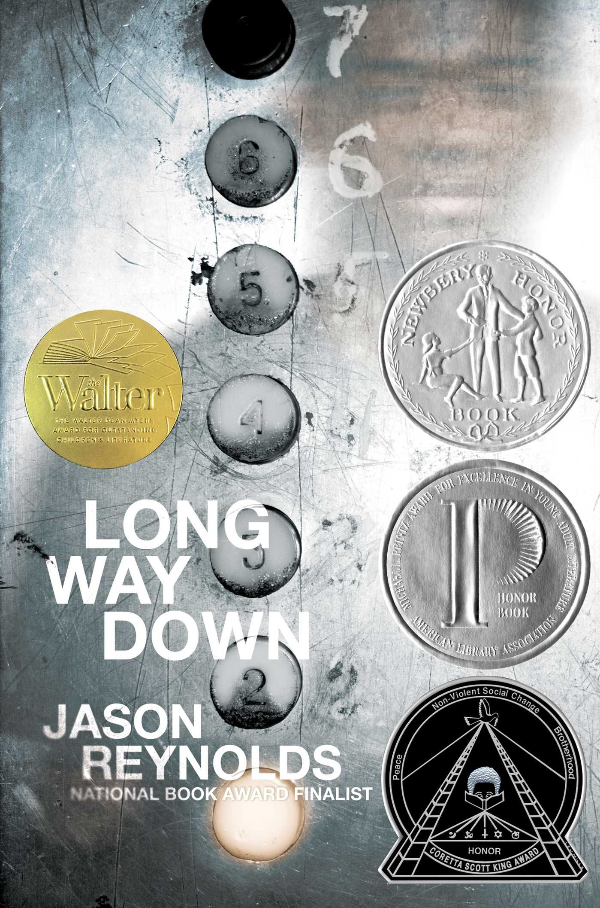
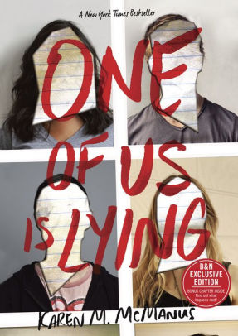
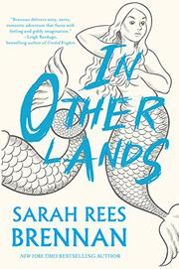
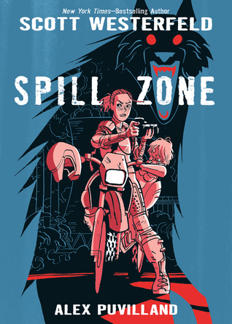
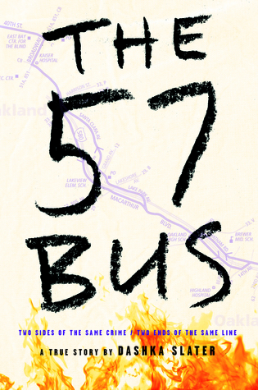
POTTY POST
IN-"STALL"-MENT
When 17-year-old Rowan Chase finds a skeleton on her family's property, she has no idea that investigating the brutal century-old murder will lead to a summer of painful discoveries about the present and the past. Nearly 100 years earlier, a misguided violent encounter propels 17-year-old Will Tillman into a racial firestorm. In a country rife with violence against blacks and a hometown segregated by Jim Crow, Will must make hard choices on a painful journey towards self-discovery and face his inner demons in order to do what's right the night Tulsa burns. Through intricately interwoven alternating perspectives, Jennifer Latham's lightning pace brings the Tulsa race riot of 1921 to blazing life and raises important questions about the complex state of US race relations - both yesterday and today.
Dreamland Burning
By: Jennifer Latham
Call #: FIC LAT
A Virginia Readers' Choice (VRC) selection. To participate in Virginia Readers' Choice read at least four of the ten books on the VRC book list. Visit the library for more information

Slide 2
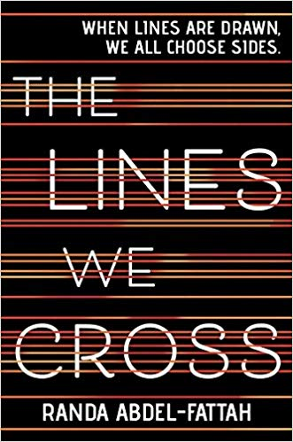
POTTY POST
IN-"STALL"-MENT
Yale hopeful Bronwyn has never publicly broken a rule. Sports star Cooper only knows what he's doing in the baseball diamond. Bad boy Nate is one misstep away from a life of crime. Prom queen Addy is holding together the cracks in her perfect life. And outsider Simon, creator of the notorious gossip app at Bayview High, won't ever talk about any of them again. He dies 24 hours before he could post their deepest secrets online. Investigators conclude it's no accident. All of them are suspects. Everyone has secrets, right? What really matters is how far you'll go to protect them.
One of Us is Lying
By: Karen M. McManus
Call #: FIC MAN
A Virginia Readers' Choice (VRC) selection. To participate in Virginia Readers' Choice read at least four of the ten books on the VRC book list. Visit the library for more information

Slide 3
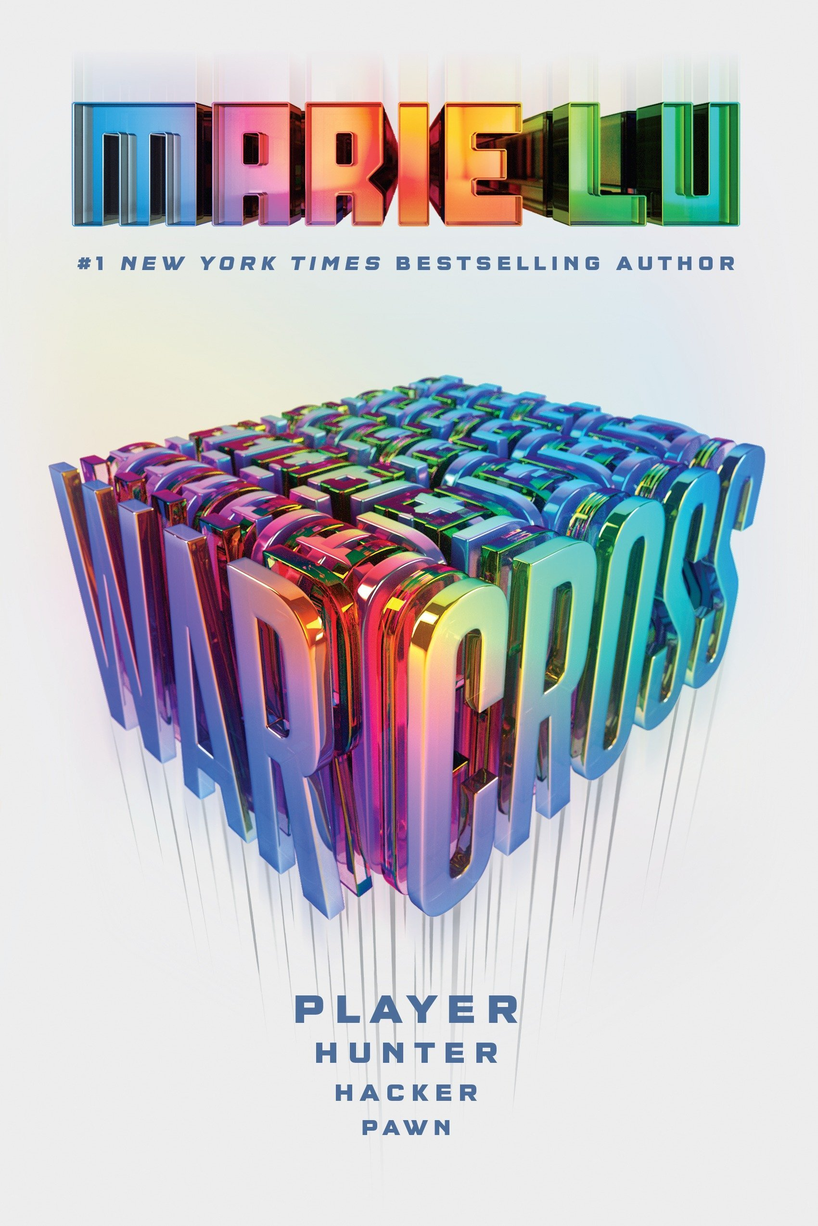
POTTY POST
IN-"STALL"-MENT
Sometimes it’s not the kid you expect who falls through to magicland, sometimes it’s . . . Elliott. He’s grumpy, nerdy, and appalled by both the dearth of technology and the levels of fitness involved in swinging swords around. He’s a little enchanted by the elves and mermaids. Despite his aversion to war, work, and most people (human or otherwise) he finds that two unlikely ideas, friendship and world peace, may actually be possible.
In Other Lands
By: Sarah Rees Brennan
Call #: FIC BRE
A Virginia Readers' Choice (VRC) selection. To participate in Virginia Readers' Choice read at least four of the ten books on the VRC book list. Visit the library for more information

Slide 4
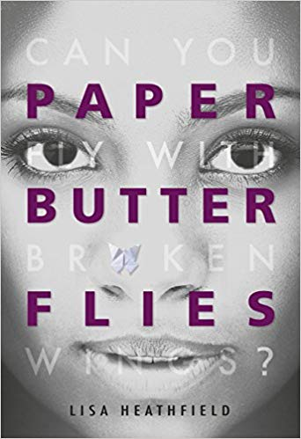
POTTY POST
IN-"STALL"-MENT
Nobody's ever really explained the Spill. Was it an angelic visitation? A nanotech accident? A porthole opening from another world? Whatever it was, no one's allowed in the Spill Zone these days except government scientists and hazmat teams. But a few intrepid explorers know how to sneak through the patrols and steer clear of the dangers inside the Zone. Addison Merrick is one such explorer, dedicated to finding out what happened that night and to unraveling the events that took her parents and left her little sister mute and disconnected from the world.
Spill Zone
By: Alex Puvilland
Call #: GN 741.5 PUV
A Virginia Readers' Choice (VRC) selection. To participate in Virginia Readers' Choice read at least four of the ten books on the VRC book list. Visit the library for more information

Slide 5
POTTY POST
IN-"STALL"-MENT
One teenager in a skirt. One teenager with a lighter. One moment that changes both of their lives forever. If it weren't for the 57 bus, Sasha and Richard never would have met. Both were high school students from Oakland, California, one of the most diverse cities in the country, but they inhabited different worlds. Sasha, a white teen, lived in the middle-class foothills and attended a small private school. Richard, a black teen, lived in the crime-plagued flatlands and attended a large public one. Each day, their paths overlapped for a mere eight minutes. But one afternoon on the bus ride home from school, a single reckless act left Sasha severely burned, and Richard charged with two hate crimes and facing life imprisonment. The case garnered international attention, thrusting both teenagers into the spotlight.
The 57 bus
By: Dashka Slater
Call #: 364.15
A Virginia Readers' Choice (VRC) selection. To participate in Virginia Readers' Choice read at least four of the ten books on the VRC book list. Visit the library for more information

Slide 6
POTTY POST
IN-"STALL"-MENT
AND THEN THERE WERE SHOTS Everybody ran, ducked, hid, tucked themselves tight. Pressed our lips to the pavement and prayed the boom, followed by the buzz of a bullet, didn't meet us. After Will's brother is shot in a gang crime, he knows the next steps. Don't cry. Don't snitch. Get revenge. So he gets in the lift with Shawn's gun, determined to follow The Rules. Only when the lift door opens, Buck walks in, Will's friend who died years ago. And Dani, who was shot years before that. As more people from his past arrive, Will has to ask himself if he really knows what he's doing.
Long Way Down
By: Jason Reynolds
Call #: FIC REY
This haunting, lyrical, powerful verse novel will blow you away
A Virginia Readers' Choice (VRC) selection. To participate in Virginia Readers' Choice read at least four of the ten books on the VRC book list. Visit the library for more information

Slide 7
POTTY POST
IN-"STALL"-MENT
Before Mina, my life was like a completed jigsaw puzzle but Mina has pushed the puzzle onto the floor. I have to start all over again, figuring out where the pieces go. When Michael meets Mina, they are at a rally for refugees - standing on opposite sides. Mina fled Afghanistan with her mother via a refugee camp, a leaky boat and a detention centre. Michael's parents have founded a new political party called Aussie Values. They want to stop the boats. Mina wants to stop the hate. When Mina wins a scholarship to Michael's private school, their lives crash together blindingly. A novel for anyone who wants to fight for love, and against injustice.
The Lines We Cross
By: Randa Abdel-Fattah
Call #: FIC ABD
A Virginia Readers' Choice (VRC) selection. To participate in Virginia Readers' Choice read at least four of the ten books on the VRC book list. Visit the library for more information

Slide 8
POTTY POST
IN-"STALL"-MENT
When a game called Warcross takes the world by storm, one girl hacks her way into its dangerous depths. For the millions who log in every day, Warcross isn't just a game—it's a way of life. Struggling to make ends meet, teenage hacker Emika Chen works as a bounty hunter, tracking down players who bet on the game illegally. When Emika hacks into the game illegally, she's convinced she'll be arrested, and is shocked when she gets a call from the game's creator, the elusive young billionaire Hideo Tanaka, with an irresistible offer. He needs a spy on the inside of this year's tournament in order to uncover a security problem ... and he wants Emika for the job. In this sci-fi thriller, #1 New York Times bestselling author Marie Lu conjures an immersive, exhilarating world where choosing who to trust may be the biggest gamble of all.
Warcross
By: Marie Lu
Call #: FIC Lu
A Virginia Readers' Choice (VRC) selection. To participate in Virginia Readers' Choice read at least four of the ten books on the VRC book list. Visit the library for more information

Slide 9
POTTY POST
IN-"STALL"-MENT
June's life at home with her stepmother and stepsister is a dark one—and a secret one. She is trapped like a butterfly in a net. But then June meets Blister, a boy in the woods. In him she recognizes the tiniest glimmer of hope that perhaps she can find a way to fly far, far away from her home and be free. Because every creature in this world deserves their freedom... But at what price?
Paper Butterflies
By: Lisa Heathfield
Call #: FIC HEA
A Virginia Readers' Choice (VRC) selection. To participate in Virginia Readers' Choice read at least four of the ten books on the VRC book list. Visit the library for more information

Slide 10
POTTY POST
IN-"STALL"-MENT
From acclaimed author Patricia Hruby Powell comes the story of a landmark civil rights case, told in spare and gorgeous verse. In 1955, in Caroline County, Virginia, amidst segregation and prejudice, injustice and cruelty, two teenagers fell in love. Their life together broke the law, but their determination would change it. Richard and Mildred Loving were at the heart of a Supreme Court case that legalized marriage between races, and a story of the devoted couple who faced discrimination, fought it, and won.
Loving VS Virginia
By: Jason Reynolds
Call #: FIC POW
A Virginia Readers' Choice (VRC) selection. To participate in Virginia Readers' Choice read at least four of the ten books on the VRC book list. Visit the library for more information

