Slide 1
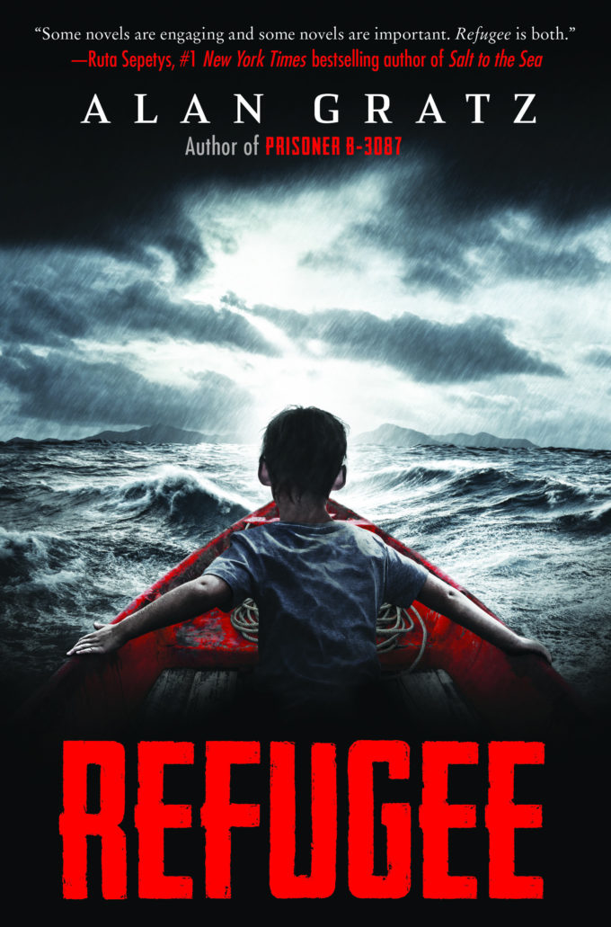
VRC Selection
YOUR NEXT GREAT READ!!
“One mission in common: ESCAPE.
Josef is a Jewish boy in 1930s Nazi Germany. With the threat of concentration camps looming, he and his family board a ship bound for the other side of the world…
Isabel is a Cuban girl in 1994. With riots and unrest plaguing her country, she and her family set out on a raft, hoping to find safety and freedom in America…
Mahmoud is a Syrian boy in 2015. With his homeland torn apart by violence and destruction, he and his family begin a long trek toward Europe…
All three young people will go on harrowing journeys in search of refuge. All will face unimaginable dangers–from drownings to bombings to betrayals. But for each of them, there is always the hope of tomorrow. And although Josef, Isabel, and Mahmoud are separated by continents and decades, surprising connections will tie their stories together in the end.
Refugee
By: Alan Gratz
Call #: FIC GRA
Historical Fiction
A Virginia Readers' Choice (VRC) selection. To participate in Virginia Readers' Choice read at least four of the ten books on the VRC book list. Visit the library for more information
Interested in this book? Carefully tear off a strip and find the book on the shelf! If the book is not in, see the librarian to place it on hold!
Refugee
Call #: FIC GRA
Historical Fiction
Refugee
Call #: FIC GRA
Historical Fiction
Refugee
Call #: FIC GRA
Historical Fiction
Refugee
Call #: FIC GRA
Historical Fiction
Refugee
Call #: FIC GRA
Historical Fiction
Refugee
Call #: FIC GRA
Historical Fiction
Refugee
Call #: FIC GRA
Historical Fiction
Refugee
Call #: FIC GRA
Historical Fiction
Refugee
Call #: FIC GRA
Historical Fiction

Slide 2
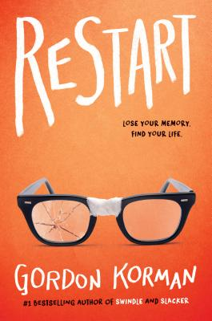
VRC Selection
YOUR NEXT GREAT READ!!
Chase's memory just went out the window.
Chase doesn't remember falling off the roof. He doesn't remember hitting his head. He doesn't, in fact, remember anything. He wakes up in a hospital room and suddenly has to learn his whole life all over again . . . starting with his own name.
He knows he's Chase. But who is Chase? When he gets back to school, he sees that different kids have very different reactions to his return.
Some kids treat him like a hero. Some kids are clearly afraid of him. One girl in particular is so angry with him that she pours her frozen yogurt on his head the first chance she gets. Pretty soon, it's not only a question of who Chase is--it's a question of who he was . . . and who he's going to be…
Restart
By: Gordon Kormon
Call #: FIC KOR
Realistic Fiction
A Virginia Readers' Choice (VRC) selection. To participate in Virginia Readers' Choice read at least four of the ten books on the VRC book list. Visit the library for more information
Interested in this book? Carefully tear off a strip and find the book on the shelf! If the book is not in, see the librarian to place it on hold!
Restart
Call #: FIC KOR
Realistic Fiction
Restart
Call #: FIC KOR
Realistic Fiction
Restart
Call #: FIC KOR
Realistic Fiction
Restart
Call #: FIC KOR
Realistic Fiction
Restart
Call #: FIC KOR
Realistic Fiction
Restart
Call #: FIC KOR
Realistic Fiction
Restart
Call #: FIC KOR
Realistic Fiction
Restart
Call #: FIC KOR
Realistic Fiction
Restart
Call #: FIC KOR
Realistic Fiction

Slide 3
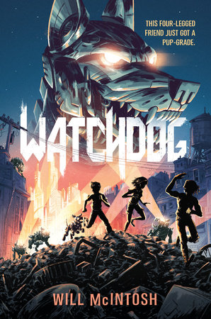
VRC Selection
YOUR NEXT GREAT READ!!
Thirteen-year-old twins Vick and Tara have built an incredible machine--a loyal robotic watchdog named Daisy. But, when local crime boss Ms. Alba schemes to add Daisy to her robot army, Vick and Tara must go to great lengths to protect their prized pet. Because Daisy is more than just any robot--she's their constant protector, and together the three make a great team. Vick and Tara are determined to stop the mob from tearing their little family apart. And they might just succeed! Sure, the evil Ms. Alba has more robot watchdogs, but none are as smart--or as faithful--as their Daisy. Plus, if things get too dangerous, Tara could always upgrade their pet. With her mechanical skills, she could make Daisy bigger, stronger, and a lot more intimidating!
Watchdog
By: Will McIntosh
Call #: FIC WIL
Science Fiction - Adventure
A Virginia Readers' Choice (VRC) selection. To participate in Virginia Readers' Choice read at least four of the ten books on the VRC book list. Visit the library for more information
Interested in this book? Carefully tear off a strip and find the book on the shelf! If the book is not in, see the librarian to place it on hold!
Watchdog
Call #: FIC MCI
Science Fiction
Watchdog
Call #: FIC MCI
Science Fiction
Watchdog
Call #: FIC MCI
Science Fiction
Watchdog
Call #: FIC MCI
Science Fiction
Watchdog
Call #: FIC MCI
Science Fiction
Watchdog
Call #: FIC MCI
Science Fiction
Watchdog
Call #: FIC MCI
Science Fiction
Watchdog
Call #: FIC MCI
Science Fiction
Watchdog
Call #: FIC MCI
Science Fiction

Slide 4
VRC Selection
YOUR NEXT GREAT READ!!
Sixth grade is coming to an end, and so is life as Macy McMillan knows it. Already a For Sale sign mars the front lawn of her beloved house. Soon her mother will upend their little family, adding an unwelcome stepfather and pesky six-year-old twin stepsisters. To add insult to injury, what is Macy s final sixth grade assignment? A genealogy project. Well, she'll put it off―just like those wedding centerpieces she's supposed to be making. Just when Macy's mother ought to be sympathetic, she sends her next door to help eighty-six-year-old Iris Gillan, who is also getting ready to move―in her case, into an assisted living facility. Iris can't move a single box on her own and, worse, she doesn't know sign language. How is Macy supposed to understand her? But Iris has stories to tell, and she isn't going to let Macy's deafness stop her. Soon, through notes and books and cookies, a friendship grows. And this friendship, odd and unexpected, may be just what Macy needs to face the changes in her life.
Macy McMillan and the
Rainbow Goddess
By: Shari Green
Call #: FIC GRE
Realistic Fiction
A Virginia Readers' Choice (VRC) selection. To participate in Virginia Readers' Choice read at least four of the ten books on the VRC book list. Visit the library for more information
Interested in this book? Carefully tear off a strip and find the book on the shelf! If the book is not in, see the librarian to place it on hold!
Macy McMillan….
Call #: FIC GRE
Realistic Fiction
Macy McMillan….
Call #: FIC GRE
Realistic Fiction
Macy McMillan….
Call #: FIC GRE
Realistic Fiction
Macy McMillan….
Call #: FIC GRE
Realistic Fiction
Macy McMillan….
Call #: FIC GRE
Realistic Fiction
Macy McMillan….
Call #: FIC GRE
Realistic Fiction
Macy McMillan….
Call #: FIC GRE
Realistic Fiction
Macy McMillan….
Call #: FIC GRE
Realistic Fiction
Macy McMillan….
Call #: FIC GRE
Realistic Fiction

Slide 5
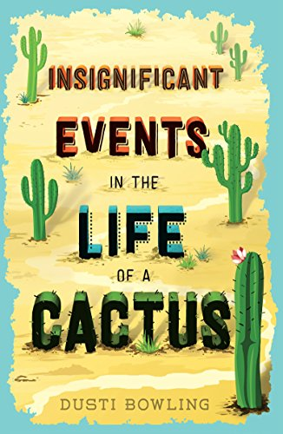
VRC Selection
YOUR NEXT GREAT READ!!
Aven Green loves to tell people that she lost her arms in an alligator wrestling match, or a wildfire in Tanzania, but the truth is she was born without them. And when her parents take a job running Stagecoach Pass, a rundown western theme park in Arizona, Aven moves with them across the country knowing that she’ll have to answer the question over and over again. Her new life takes an unexpected turn when she bonds with Connor, a classmate who also feels isolated because of his own disability, and they discover a room at Stagecoach Pass that holds bigger secrets than Aven ever could have imagined. It’s hard to solve a mystery, help a friend, and face your worst fears. But Aven’s about to discover she can do it all . . . even without arms.
Insignificant Events in the
Life of a Cactus
By: Dusti Bowling
Call #: FIC BOW
Realistic Fiction
A Virginia Readers' Choice (VRC) selection. To participate in Virginia Readers' Choice read at least four of the ten books on the VRC book list. Visit the library for more information
Interested in this book? Carefully tear off a strip and find the book on the shelf! If the book is not in, see the librarian to place it on hold!
Insignificant Events…
Call #: FIC BOW
Realistic Fiction
Insignificant Events…
Call #: FIC BOW
Realistic Fiction
Insignificant Events…
Call #: FIC BOW
Realistic Fiction
Insignificant Events…
Call #: FIC BOW
Realistic Fiction
Insignificant Events…
Call #: FIC BOW
Realistic Fiction
Insignificant Events…
Call #: FIC BOW
Realistic Fiction
Insignificant Events…
Call #: FIC BOW
Realistic Fiction
Insignificant Events…
Call #: FIC BOW
Realistic Fiction
Insignificant Events…
Call #: FIC BOW
Realistic Fiction

Slide 6
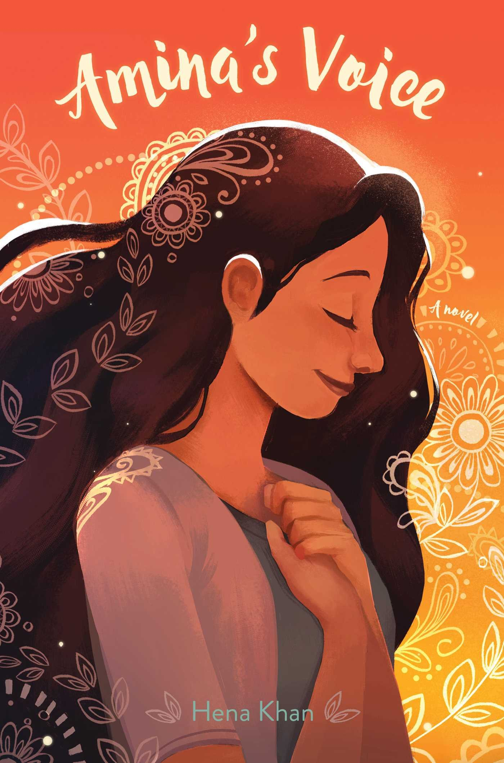
VRC Selection
YOUR NEXT GREAT READ!!
Amina has never been comfortable in the spotlight. She is happy just hanging out with her best friend, Soojin. Except now that she’s in middle school everything feels different. Soojin is suddenly hanging out with Emily, one of the “cool” girls in the class, and even talking about changing her name to something more “American.” Does Amina need to start changing too? Or hiding who she is to fit in? While Amina grapples with these questions, she is devastated when her local mosque is vandalized.
Amina’s Voice
By: Hena Khan
Call #: FIC KHA
Realistic Fiction
A Virginia Readers' Choice (VRC) selection. To participate in Virginia Readers' Choice read at least four of the ten books on the VRC book list. Visit the library for more information
Interested in this book? Carefully tear off a strip and find the book on the shelf! If the book is not in, see the librarian to place it on hold!
Amina’s Voice
Call #: FIC KHA
Realistic Fiction
Amina’s Voice
Call #: FIC KHA
Realistic Fiction
Amina’s Voice
Call #: FIC KHA
Realistic Fiction
Amina’s Voice
Call #: FIC KHA
Realistic Fiction
Amina’s Voice
Call #: FIC KHA
Realistic Fiction
Amina’s Voice
Call #: FIC KHA
Realistic Fiction
Amina’s Voice
Call #: FIC KHA
Realistic Fiction
Amina’s Voice
Call #: FIC KHA
Realistic Fiction
Amina’s Voice
Call #: FIC KHA
Realistic Fiction

Slide 7
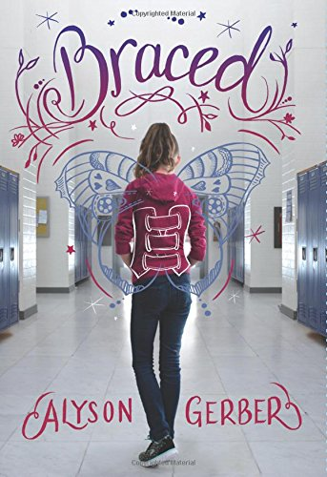
VRC Selection
YOUR NEXT GREAT READ!!
Rachel Brooks is excited for the new school year. She's finally earned a place as a forward on her soccer team. Her best friends make everything fun. And she really likes Tate, and she's pretty sure he likes her back. After one last appointment with her scoliosis doctor, this will be her best year yet. Then the doctor delivers some terrible news: The sideways curve in Rachel's spine has gotten worse, and she needs to wear a back brace twenty-three hours a day. The brace wraps her in hard plastic from shoulder blades to hips. It changes how her clothes fit, how she kicks a ball, and how everyone sees her -- even her friends and Tate. But as Rachel confronts all the challenges the brace presents, the biggest change of all may lie in how she sees herself.
Braced
By: Alyson Gerber
Call #: FIC GER
Realistic Fiction
A Virginia Readers' Choice (VRC) selection. To participate in Virginia Readers' Choice read at least four of the ten books on the VRC book list. Visit the library for more information
Interested in this book? Carefully tear off a strip and find the book on the shelf! If the book is not in, see the librarian to place it on hold!
Braced
Call #: FIC GER
Realistic Fiction
Braced
Call #: FIC GER
Realistic Fiction
Braced
Call #: FIC GER
Realistic Fiction
Braced
Call #: FIC GER
Realistic Fiction
Braced
Call #: FIC GER
Realistic Fiction
Braced
Call #: FIC GER
Realistic Fiction
Braced
Call #: FIC GER
Realistic Fiction
Braced
Call #: FIC GER
Realistic Fiction
Braced
Call #: FIC GER
Realistic Fiction

Slide 8
VRC Selection
YOUR NEXT GREAT READ!!
Welles Crowther didn't see himself as a hero. He was just an ordinary kid who played sports, volunteered for the fire department in his town, and eventually headed off to college and then to Wall Street to start a career. Throughout it all, he always kept a red bandanna in his pocket, a gift from his father when he was little. On September 11, 2001, Welles was at his job on the 104th floor of the South Tower of the World Trade Center when the Twin Towers were attacked. What he did next would alter the course of many lives. That day, the legend of the Man in the Red Bandanna was born.
The Red Bandanna
By: Tom Rinaldi
Call #: 92 CRO
Biography
A Virginia Readers' Choice (VRC) selection. To participate in Virginia Readers' Choice read at least four of the ten books on the VRC book list. Visit the library for more information
Interested in this book? Carefully tear off a strip and find the book on the shelf! If the book is not in, see the librarian to place it on hold!
The Red Bandanna
Call #: 92 CRO
Biography
The Red Bandanna
Call #: 92 CRO
Biography
The Red Bandanna
Call #: 92 CRO
Biography
The Red Bandanna
Call #: 92 CRO
Biography
The Red Bandanna
Call #: 92 CRO
Biography
The Red Bandanna
Call #: 92 CRO
Biography
The Red Bandanna
Call #: 92 CRO
Biography
The Red Bandanna
Call #: 92 CRO
Biography
The Red Bandanna
Call #: 92 CRO
Biography

Slide 9
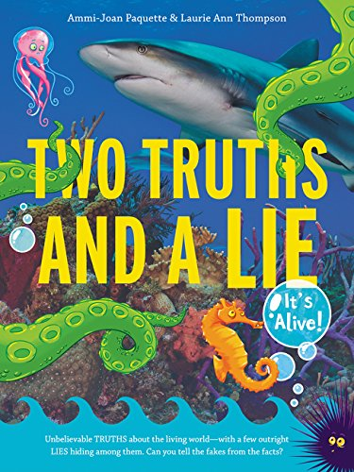
VRC Selection
YOUR NEXT GREAT READ!!
Two Truths and a Lie is the first book in a new series that presents some of the most crazy-but-true stories about the living world as well as a handful of stories that are too crazy to be true—and asks readers to separate facts from fakes! Did you know that there is a fungus that can control the mind of an ant and make it do its bidding? Would you believe there is such a thing as a corpse flower—a ten-foot-tall plant with a blossom that smells like a zombie? Every story in this book is strange and astounding. But not all of them are real. Just like the old game in this book’s title, two out of every three stories are completely true and one is an outright lie. Can you guess which? It’s not going to be easy. Some false stories are based on truth, and some of the true stories are just plain unbelievable.
Two Truths and a Lie
By: Ammi-Joan Paquette and Laurie Ann Thompson
Call #: 591 PAQ
Non-Fiction
A Virginia Readers' Choice (VRC) selection. To participate in Virginia Readers' Choice read at least four of the ten books on the VRC book list. Visit the library for more information
Interested in this book? Carefully tear off a strip and find the book on the shelf! If the book is not in, see the librarian to place it on hold!
Two Truths and a Lie
Call #: 591 PAQ
Non- Fiction
Two Truths and a Lie
Call #: 591 PAQ
Non- Fiction
Two Truths and a Lie
Call #: 591 PAQ
Non- Fiction
Two Truths and a Lie
Call #: 591 PAQ
Non- Fiction
Two Truths and a Lie
Call #: 591 PAQ
Non- Fiction
Two Truths and a Lie
Call #: 591 PAQ
Non- Fiction
Two Truths and a Lie
Call #: 591 PAQ
Non- Fiction
Two Truths and a Lie
Call #: 591 PAQ
Non- Fiction
Two Truths and a Lie
Call #: 591 PAQ
Non- Fiction

Slide 10
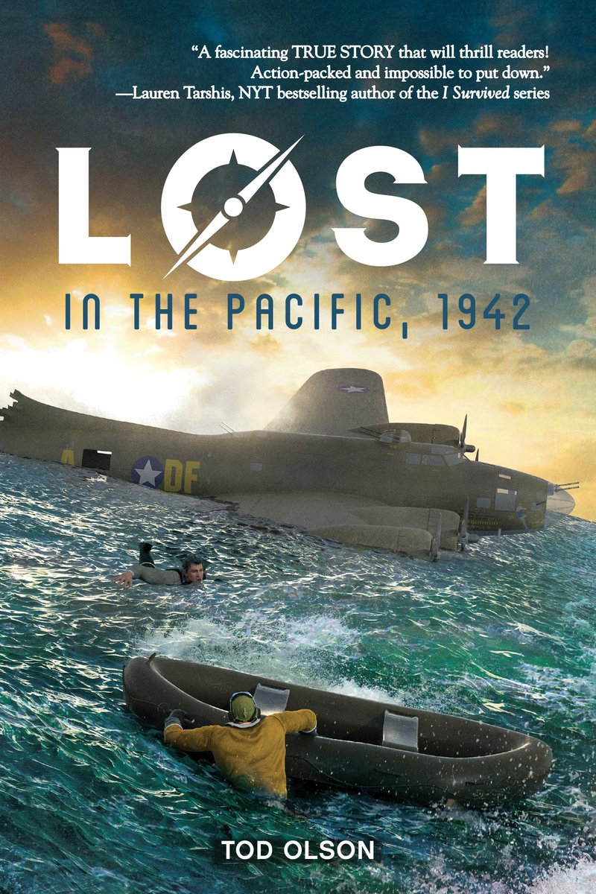
VRC Selection
YOUR NEXT GREAT READ!!
LOST IN THE PACIFIC is the first book in a new narrative nonfiction series that tells the true story of a band of World War II soldiers who became stranded at sea and had to fight for survival. ​ World War II, October 21, 1942. A B-17 bomber drones high over the Pacific Ocean, sending a desperate SOS into the air. The crew is carrying America's greatest living war hero on a secret mission deep into the battle zone. But the plane is lost, burning through its final gallons of fuel. At 1:30 p.m., there is only one choice left: an emergency landing at sea. If the crew survives the impact, they will be left stranded without food or water hundreds of miles from civilization. Eight men. Three inflatable rafts. Sixty-eight million square miles of ocean. What will it take to make it back alive?
Lost in the Pacific, 1942
By: Tod Olson
Call #: 940.54 OLS
Non-Fiction
A Virginia Readers' Choice (VRC) selection. To participate in Virginia Readers' Choice read at least four of the ten books on the VRC book list. Visit the library for more information
Interested in this book? Carefully tear off a strip and find the book on the shelf! If the book is not in, see the librarian to place it on hold!
Lost in the Pacific
Call #: 940.54 OLS
Non-Fiction
Lost in the Pacific
Call #: 940.54 OLS
Non-Fiction
Lost in the Pacific
Call #: 940.54 OLS
Non-Fiction
Lost in the Pacific
Call #: 940.54 OLS
Non-Fiction
Lost in the Pacific
Call #: 940.54 OLS
Non-Fiction
Lost in the Pacific
Call #: 940.54 OLS
Non-Fiction
Lost in the Pacific
Call #: 940.54 OLS
Non-Fiction
Lost in the Pacific
Call #: 940.54 OLS
Non-Fiction
Lost in the Pacific
Call #: 940.54 OLS
Non-Fiction

